Slide 1



House Price Prediction
Project Short Summary
This project addresses the challenge of determining optimal house prices by utilizing data analytics and machine learning. The development approach involves data collection, preprocessing, and the application of various machine learning algorithms, including the Gradient Boosting Regressor. Model evaluation is conducted using Mean Absolute Percentage Error (MAPE). The project's success is demonstrated through the effective deployment of the model for real-time predictions, showcasing the accuracy of the Gradient Boosting Regressor in predicting house prices. Future improvements aim to incorporate additional data sources, optimize algorithms, and expand the system to cover multiple cities or regions.
Program Feedback
The project effectively outlines the objective of leveraging data analytics and machine learning for real-time house price prediction. While the success of the Gradient Boosting Regressor is highlighted, including more details about the data used, exploring other algorithms for comparison, and providing specific performance metrics (such as MAPE) would enhance the overall impact. Additionally, discussing any challenges encountered and suggesting future improvements (such as incorporating more diverse data) would present a more comprehensive view of the project.
NIRAJ KUMAR SINGH
nirajsingh9570460932@gmail.com
AMITY UNIVERSITY PATNA
#skillsbuild

Slide 2
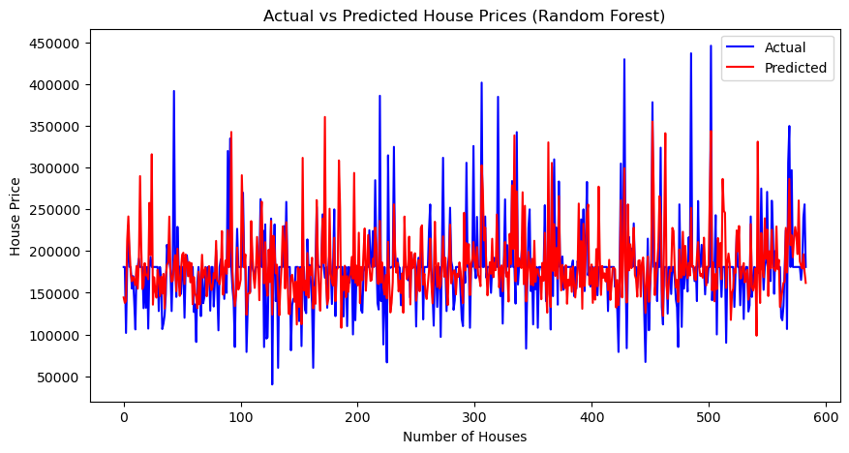
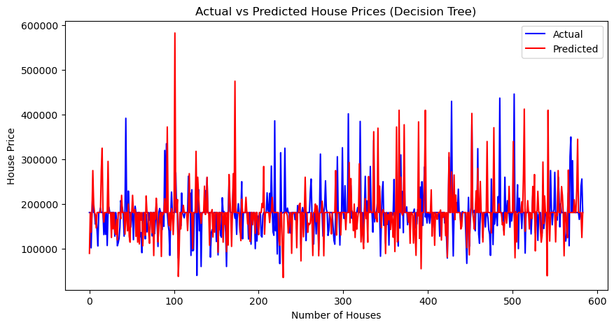

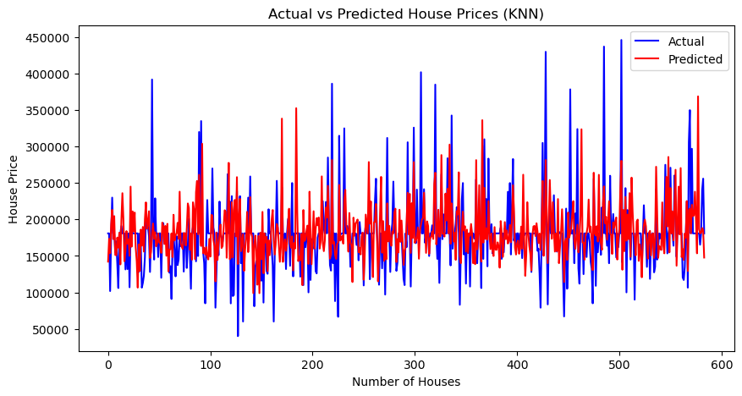
Final project Outcome Screenshot

Slide 3
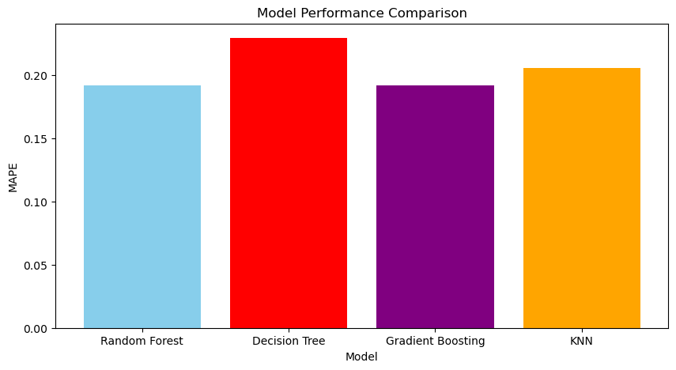
Final project Outcome Screenshot

